Slide 1
Age-related macular degeneration
(AMD)

Slide 2
Contents
What is ARMD?
How common is it?
The symptoms
Two types – Dry & Wet
Tests for ARMD
Treatment and managing vision loss

Slide 3
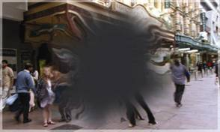
What is age-related macular degeneration (AMD)?
Damage or breakdown of the macula that occurs with age

Slide 4
The macula
Small area of the retina used for central vision
Provides fine, detailed vision
Used for reading, close work, looking at faces

Slide 5
AMD becomes more common with age

Slide 6
Symptoms of AMD
Loss of your central vision
Vision loss is often gradual
People notice problems reading, even with their glasses on
Side vision is usually unaffected

Slide 7
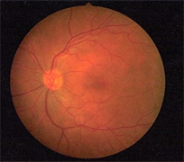
Normal retina
Veins
Optic nerve
Macula

Slide 8
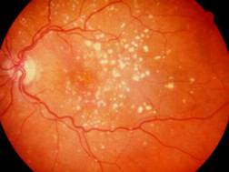
Types of AMD
Dry type
Better visual outcome
Small deposits called “Drusen” form around the macular area
No treatment, only regular review

Slide 9
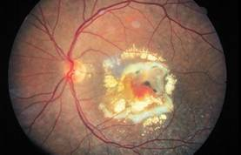
Types of AMD
Wet type
More serious
Fluid accumulates underneath retina, causing distortion
Requires immediate ophthalmological treatment

Slide 10
Tests for AMD
Ophthalmoscopy
instruments which enable an optometrist to see the retina
The Amsler grid
can be used at home for self monitoring
OCT (optical coherence tomography) machine

Slide 11
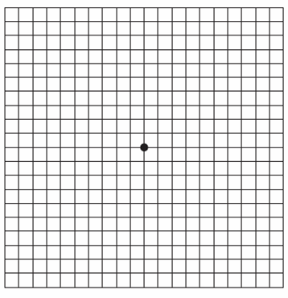
Amsler grid
Tests to see if any lines are distorted or missing

Slide 12
Treatment for AMD
When new vessels grow on the retina, surgery is an option
Surgery is best done early after serious developments occur
The aim is to prevent further vision loss

Slide 13

Managing vision loss due to AMD
Up-to-date glasses can be prescribed by optometrist
Good focal lighting
Reading during daylight
Magnification devices
An optometrist can advise you

Slide 14
Regular exams are vital
Every two years if over 40. More often if any AMD is noticed AND If you think there is a change in your vision

Slide 15
Regular exams are vital
Every two years if over 40
More often if any AMD is noticed
AND
If you think there is a change in your vision

Slide 16
Optometrists
Provide a comprehensive visual exam
Detect and diagnose eye health problems
Prescribe and supply glasses and contact lenses when required
Diagnose and treat eye coordination and focussing problems
Are university educated and undertake continuing professional education
No referral is required
Eye tests attract a Medicare rebate

Slide 17
To find an optometrist in your area:
www.optometry.org.au/find-an-optometrist/

Slide 18
Read more about Macular Degeneration
www.goodvisionforlife.com.au/vision-problems/amd/

