Slide 1
Common eye conditions
and the role of the pharmacist

Slide 2
Overview
Who’s who and where to get help
Eye health in Australia
Preventing sight loss – what can we do?
Anatomy and physiology of the eye
Dealing with an eye health problem
Common eye conditions:
  Infective Conjunctivitis
  Allergic Red Eye
  Dry Eye
  Contact Lens related issues
  Age-related macular degeneration (AMD)
  Cataract
  Diabetic retinopathy
  Glaucoma
  Refractive error

Slide 3
Optometrist
An optometrist is a primary eye care provider
University course (Undergraduate/Post Graduate)
Medicare provides a rebate on most optometry consultations
Patients do not need a referral to see an optometrist
Generally little or no waiting period for appointments
Optometrists will fast-track referrals to ophthalmologists if necessary
To locate your nearest optometrist, visit Find An Optometrist

Slide 4
How optometry prescribing works
Therapeutic endorsement is by Optometry Board of Australia
Now mandatory as part of undergraduate optometry degrees in Australia
Two-thirds of optometrists in Australia are qualified to prescribe topical eye drops
Optometrists can manage eye disease such as Glaucoma via shared care arrangements with ophthalmologists

Slide 5
What can optometrists prescribe in Australia?
Anti-infectives | Steroids & NSAIDs | Glaucoma | Anti-allergy | Cycloplegics
Antibiotics e.g. Chloramphenicol Gentamicin Tobraycin Tetracycline Ciprofloxacin (P) Ofloxacin (P) Antivirals Aciclovir | Steroids e.g. Hydrocortisone Fluorometholone Prednisolone Dexamathasone NSAIDS Ketorolac Diclofenac | e.g. Timolol Latanoprost Travoprost Bimatoprost Dorzolamide Brimonidine Apraclonidine Pilocarpine Brinzolamide | e.g. Lodoxamide Sodium cromoglycate Ketotifen Olopatadine Levocabastine | e.g. Atropine Homatropine
P – Private Rx only (non PBS) . For updated list visit Optometry Board of Australia website

Slide 6
Eye health in Australia
As the population in Australia ages, the number of people who are blind or have vision loss is expected to be over 800,000 by 2020
75% of vision loss is preventable or treatable
Prevalence increases threefold with each decade over 40 years
80% of vision loss is caused by five conditions (listed alphabetically):
  Age-related Macular Degeneration (AMD)
  Diabetic retinopathy
  Cataract
  Glaucoma
  Under-corrected and uncorrected refractive error

Slide 7
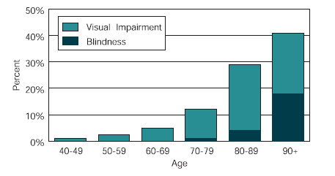
Vision loss in Australia
Center for Eye Research Australia, 2004, Investing in Sight – Strategic Interventions to Prevent Vision Loss in Australia.

Slide 8
Preventing vision loss
What pharmacists can do:
Encourage your clients to – Get your eyes tested, especially if:
  there is a family history of eye disease
  the client is over 40
  the client has diabetes
  the client has noticed a change in their vision
  the client is of Aboriginal or Torres Strait Islander descent
Recognise symptoms of common eye problems
Know where and when to refer to an optometrist
History is the key

Slide 9
Preventing vision loss
What pharmacists can do:
Talk to your clients about their vision; vision loss maybe an underlying cause for another condition
If you are concerned about a client’s vision discuss your concerns with an optometrist or treating GP
Medicare covers some of the costs associated with visiting an optometrist

Slide 10
Preventing vision loss
People with vision difficulties are at a greater risk of suffering from:
falls
depression
early special accommodation
increased risk of hip fracture
increased early mortality
social isolation

Slide 11
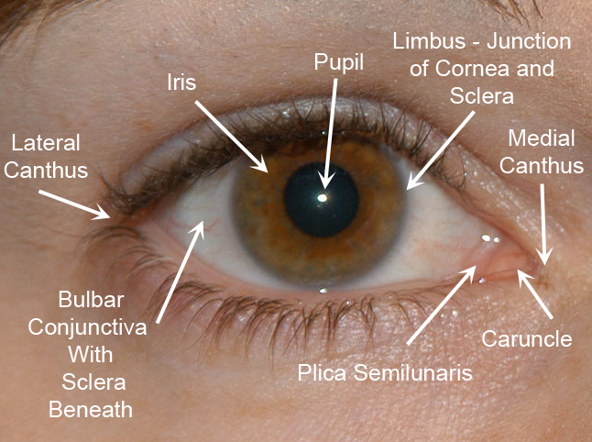
External anatomy of the eye

Slide 12
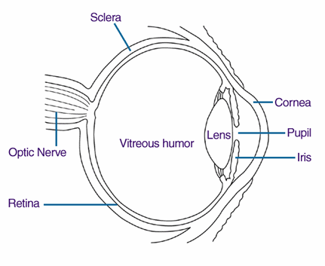
Internal anatomy of the eye

Slide 13
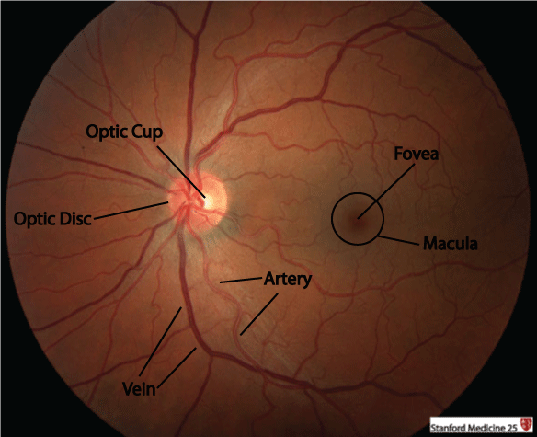

Anatomy of the retina

Slide 14
Common red eye conditions pharmacists will see
Conjunctivitis
Dry Eye
Lid crusting and inflammation (Blepharitis)
Contact Lens Complications

Slide 15
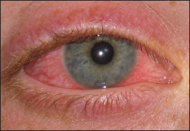
Case study 1
22 year old Ms. X attends your pharmacy asking for drops for her red eye
What do we ask the patient?
Contact Lenses?
Onset?
Vision?
Pain?
Discharge?
Trauma?
Allergies?
Recurring?
General Health (Flu, Nausea, HAs?)
Other eye?

Slide 16
Case study 1
Signs of conjunctivitis:
Redness in the white of the eye or inner eye lid
Painful eye
Eye discharge ( can be watery or mucopurulent)
Sticky eye lids on waking
Burning eyes
Itchy eyes
Increased tearing

Slide 17
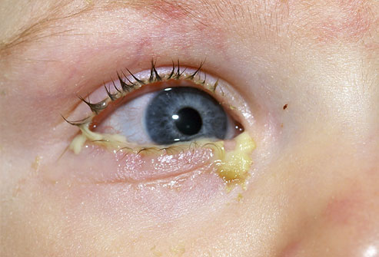
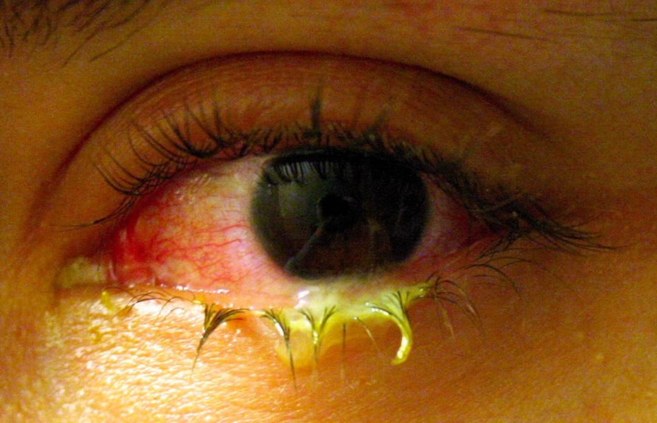
Case study 1
Causes of conjunctivitis:
Bacteria
  Causes: Staphylococcus aureus, Streptococcus pneumoniae, Haemophilus influenza
  Spread: hand to eye contact or through adjacent mucosal tissue colonisation such as nasal or sinus mucosa.

Slide 18
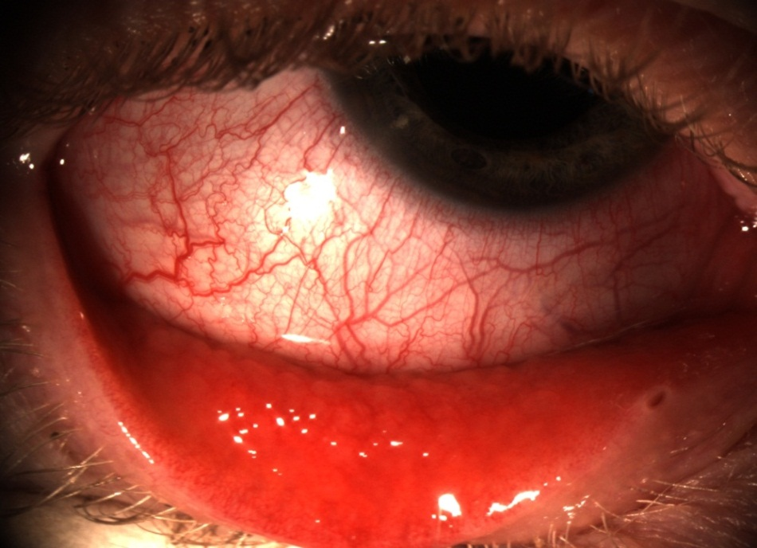
Case study 1
Causes of conjunctivitis:
Viruses
  Causes: Adenovirus (most common). Herpes Simplex Virus (HSV) & Varicella Zostor Virus (VZV) are less common.
  Spread: highly contagious and usually transmitted through inoculation of viral particles from the patient’s hand or by contact with upper respiratory droplets.

Slide 19
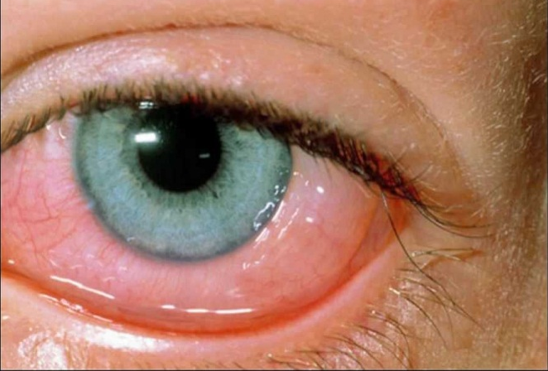
Case study 1
Causes of conjunctivitis:
Allergies
  Immunological response:
    Type I (Immediate) hypersensitivity reaction triggering mast cell degranulation
    Type IV (Delayed-type) hypersensitivity reaction – onset 48 hours after exposure.
  Subtypes:
    Seasonal Allergic Conjunctivitis (SAC) & Perennial Allergic Conjunctivitis (PAC)
    Vernal keratoconjuctivitis (VKC), Atopic keratoconjuctivitis & Giant Papillary Conjunctivitis
Irritants – e.g. shampoos, dirt, smoke, swimming pool chlorine

Slide 20
Case study 1
Differentiating conjunctivitis
Bacterial | Viral | Allergic
Mucopurulent Eye lids stuck together on waking Can be contagious May self-resolve Antibiotic treatment | Watery discharge Cause: often common cold Usually self limiting Can be transferred to other eye Cold Compressors – reduce discomfort and burning | Usually seasonal Can be perennial Typically bilateral Itchy and burning Mild redness Anti Histamine - Zaditen Mast Cell Stabiliser - Patanol

Slide 21
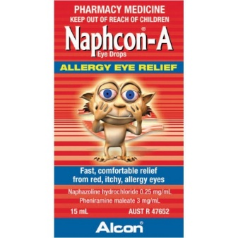
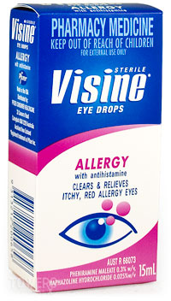
Case study 1
Conjunctivitis therapy
Allergic Non-Drug Therapy
1. Allergen Avoidance:
  Stay indoors on high pollen count days
  Protective pillowslips and bedding
  Remove carpets and rugs
  High temperature hot water laundry wash
  Showering at bedtime to avoid allergens in hair
  HEPA filter in car and home air conditioner – 99.97% removal of particles
2. Palliative
  Cold compress – Vasoconstriction and Itch Suppression (less degranulation)
Allergic OTC medication
Decongestants for Vasoconstriction (e.g. Visine)
Antihistamines to block Histamine Receptors (e.g. Livostin)
Decongestant/Antihistamine Combination (e.g. Naphcon-A)

Slide 22
Common red eye conditions pharmacists will see
Conjunctivitis
Dry Eye
Lid crusting and inflammation (Blepharitis)
Contact Lens Complications

Slide 23
Case study 1
22 year old Ms. X attends your pharmacy asking for drops for her red eye
What do we ask the patient?
Contact Lenses: positive
Onset: last night
Vision: variable (conjunctivitis?)
Pain: positive, mild (conjunctivitis?)
Discharge: positive, watery (viral?)
Trauma
Allergies
Recurring
General Health (Flu, Nausea, HAs)
Other eye

Slide 24
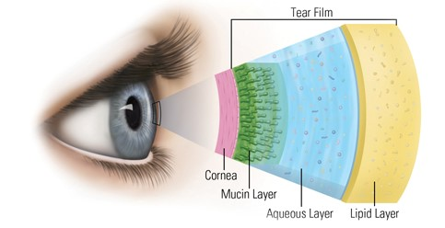
Case study 1
What is dry eye?
Disease of the tears and ocular surface
Involved the reduction in the quality or quantity of the tears present in the patient’s tear film
Symptoms:
  Discomfort
  Visual disturbance
  Tear film instability
  Potential damage to the ocular surface
The human tear film:

Slide 25
Case study 1
Symptoms and causes of dry eye
Symptoms | External factors | Internal factors
Sore or stinging eyes Itchy eyes Red eyes Watery eyes Blurred vision Pulling or tugging sensation Difficulty wearing contact lenses | Environment Concentration Eye Surgery Exposure Contact Lenses | Ageing Gender and Hormonal changes Medication Blepharitis Arthritis and autoimmune conditions

Slide 26
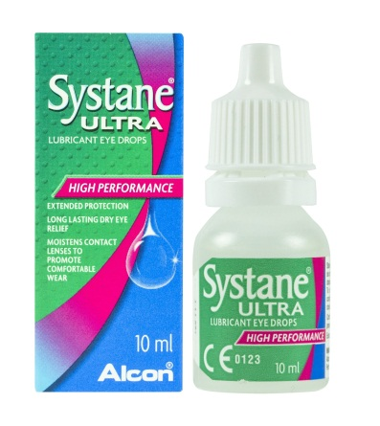
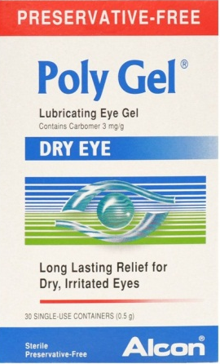
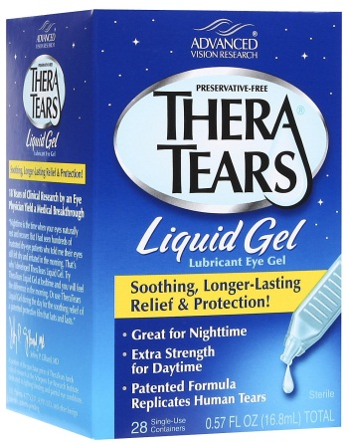
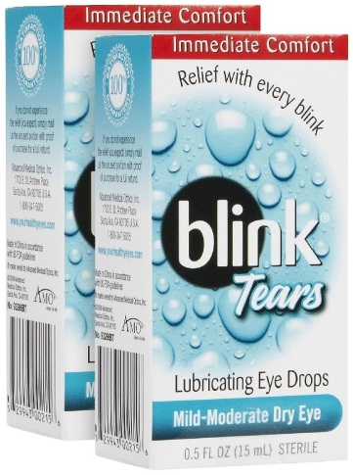
Case study 1
How dry eye is treated:
Adding tears – ocular lubricants and tear supplements may be used to provide symptomatic relief

Slide 27
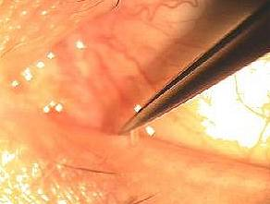
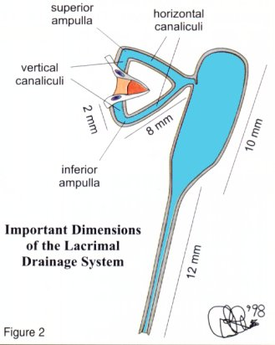
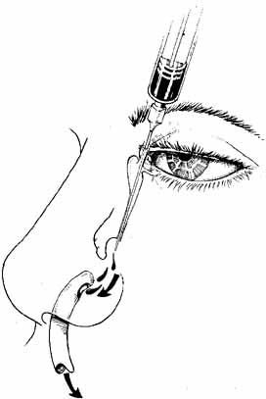
Case study 1
How dry eye is treated:
Conserving tears – in the event that ocular lubricants provide little or no relief, referral to an optometrists to insert tiny plugs into the pipe that normally drains tears can increase the volume of tears at the eye surface
Punctal Plugs for dry eye
Lacrimal Lavage for watery eyes

Slide 28


Case study 1
How dry eye is treated:
Natural supplements – Omege-3 supplements may also help with dry eye by reducing inflammation and maintain the health of the glands that provide the oily layer that prevents tear evaporation.

Slide 29
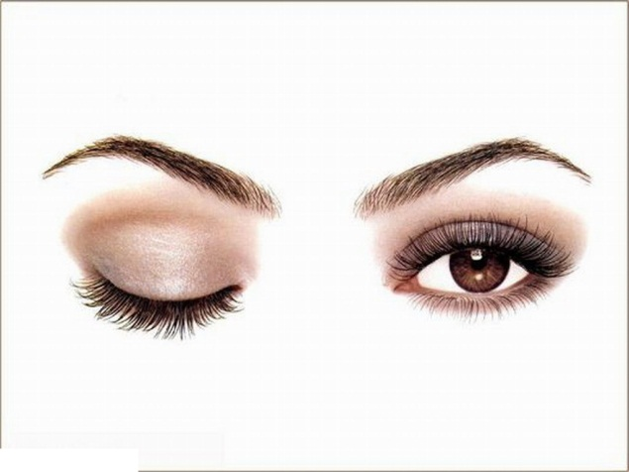


Case study 1
What else can I do to help my patients?
Drink plenty of water
Avoid excessive heating and cooling environments
Frequent breaks when using the computer or reading
Blink more often
Use Warm Compress on eyelids daily
Blink
Drink
Break

Slide 30
Common red eye conditions pharmacists will see
Conjunctivitis
Dry Eye
Lid crusting and inflammation (Blepharitis)
Contact Lens Complications

Slide 31
Case study 1
22 year old Ms. X attends your pharmacy asking for drops for her red eye
What do we ask the patient?
Contact Lenses: positive
Onset: last night (Dry Eye)
Vision: variable
Pain: positive, moderate (Dry Eye)
Discharge: positive, watery
Trauma
Allergies
Recurring
General Health (Flu, Nausea, HAs)
Other eye

Slide 32
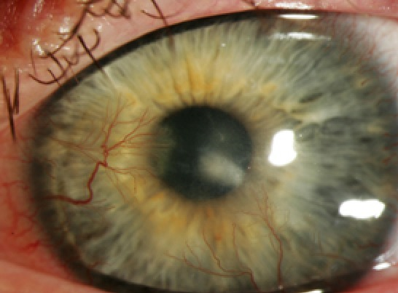
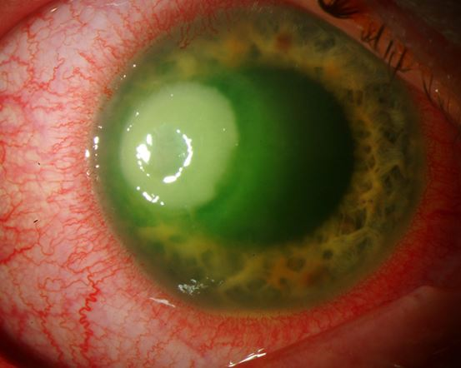
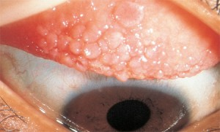
Case study 1
Contact lens complications
Contact lens related complications can arise from multiple sources and can present to a pharmacist in many different forms. These include:
  Traumatic – over wear & decreased sensitivity
  Metabolic – Neovascularisation & corneal oedema
  Toxic – Solutions & allergic responses
  Hypersensitivity – Papillary Conjunctivitis
  Infective – Bacterial Keratitis
B
E
D

Slide 33
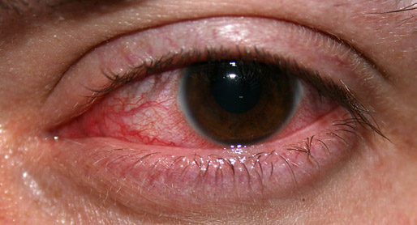
Case study 1
Signs/symptoms of contact lens complications:
Blurred vision
Global redness in the white of the eye or inner eye lid
Painful eye
Unable to open
Intolerant to contact lens wear
Burning eyes
Itchy eyes
Increased tearing
Excessive discharge

Slide 34
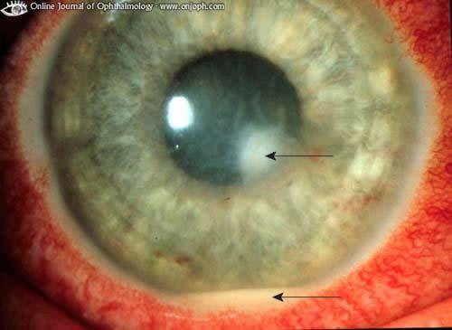
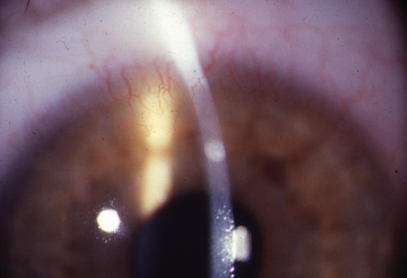
Case study 1
What does Ms. X have?
or
Corneal ulcer (infective)
P – Pain
E – Epithelium Defect
D – Discharge
A – Anterior Chamber
L – Location
Corneal infiltrate (sterile)
Reduction or absence of infective symptoms

Slide 35
Case study 1
How do we treat Ms. X?
Corneal ulcer (infective)
Monotherapy Fluoroquinolone eye drops
(Fortified Antibiotics – Gentamycin or Tobramycin)
or
Corneal infiltrate (sterile)
Fortified Antibiotic (Tobramycin) and Dexamethasone

Slide 36
Case study 1
22 year old Ms. X attends your pharmacy asking for drops for her red eye
Diagnosis: Corneal Infiltrate
Result of hypoxic effects due to extended wear
Migration of inflammatory white blood cells
Pain mild to moderate
What does Ms. X have?
Treatment:
If diagnosis is clear: Antibiotic (Tobramycin) and Dexamethasone
If diagnosis is unclear: Fluoroquinolone as a more conservative option

Slide 37
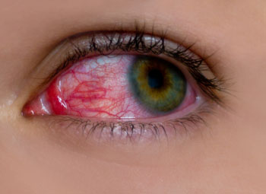
The red eye – refer or treat?
Treat when… | Refer when…
Mild red eye Itchy eyes Allergic Viral Chronic/sub-acute bacterial | Unilateral Blurred vision Pain Intolerant to contact lens wear Discharge

Slide 38
Common ocular disease conditions pharmacists will see
Diabetic retinopathy
Glaucoma

Slide 39
Case study 2
52 year old Mr. J attends your pharmacy for the first time with a prescription for his Diamox
What do we ask the patient regarding eye health?
Onset of Diabetes
Control of BSL (diets, medication, insulin)
Measure (self monitor, GP, Endo)
Vision
Eye care practitioner (optometrist, ophthalmologist)
Last eye exam?

Slide 40
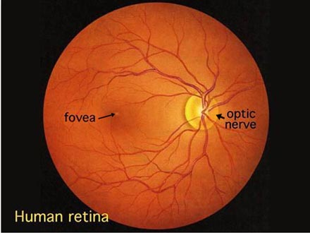
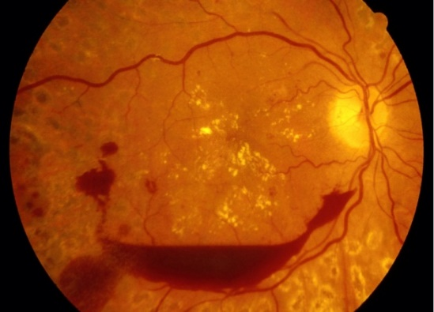
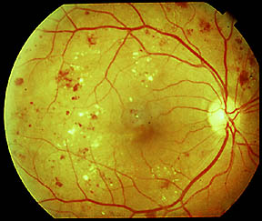
What is diabetic retinopathy?
This condition is a complication of diabetes
It affects the small blood vessels of the retina
Blood vessels begin to leak and bleed inside the eye
Healthy retina
Diabetic retinopathy

Slide 41
Prevalence and risk factors of diabetic retinopathy
It is estimated that 3% of the population aged over 55 years have diabetic retinopathy
22% of people with known Type 2 diabetes have some form of retinopathy related to their diabetes
Within 15 years of being diagnosed with diabetes, three out of four diabetics will have diabetic retinopathy
Greater Risk of DR:
  Duration
  Diabetic Kidney Disease
  Type I DM
Diabetic retinopathy is the primary vision threatening condition for Aboriginal and Torres Strait Islander people

Slide 42
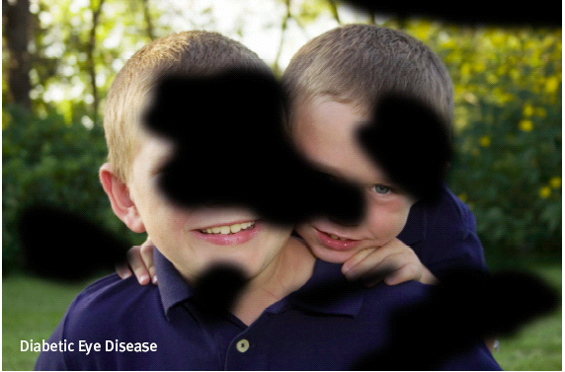
Diabetic retinopathy – functional implications
Difficulty with fine details (e.g. when reading or watching television)
Fluctuations in vision from hour to hour or day to day
Blurred, hazy or double vision
Difficulty seeing at night or in low light
Being particularly sensitive to glare and light
Having difficulty focusing

Slide 43
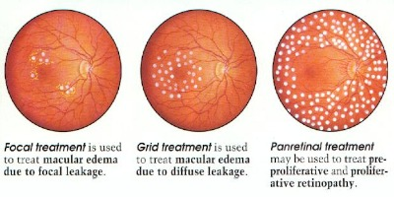
Treatment and prevention of diabetic retinopathy
Early detection and timely treatment is essential
98% of severe vision loss can be prevented with early detection and timely laser treatment
Reduction to the severity of eye disease can be achieved with optimal control of:
  Blood Sugar Levels
  Blood Pressure
  Cholesterol Levels

Slide 44
Case study 2
52 year old Mr. J attends your pharmacy for the first time with a prescription for his Diamox
What do we counsel Mr. J on regarding his eye health?
Control of diabetes (diet and medication)
Regular eye exams
Fluctuations in vision
Other visual symptoms (Floaters, Flashes, Haloes)

Slide 45
Common ocular disease conditions pharmacists will see
Diabetic retinopathy
Glaucoma

Slide 46
Glaucoma
What is glaucoma?
It is a disease that affects the optic nerve at the back of the eye due to increased Intraocular Pressure
Relieving pressure on the nerve reduces progression of the disease
Early detection and treatment can slow the vision loss
Prevalence of glaucoma
People over the age of 40 are more likely to develop glaucoma than young people.
Almost 3% of the Australian population over 55 years are affected
Glaucoma has a genetic link and can ocur in families
  First degree blood relative = eight times more likely to develop the disease

Slide 47
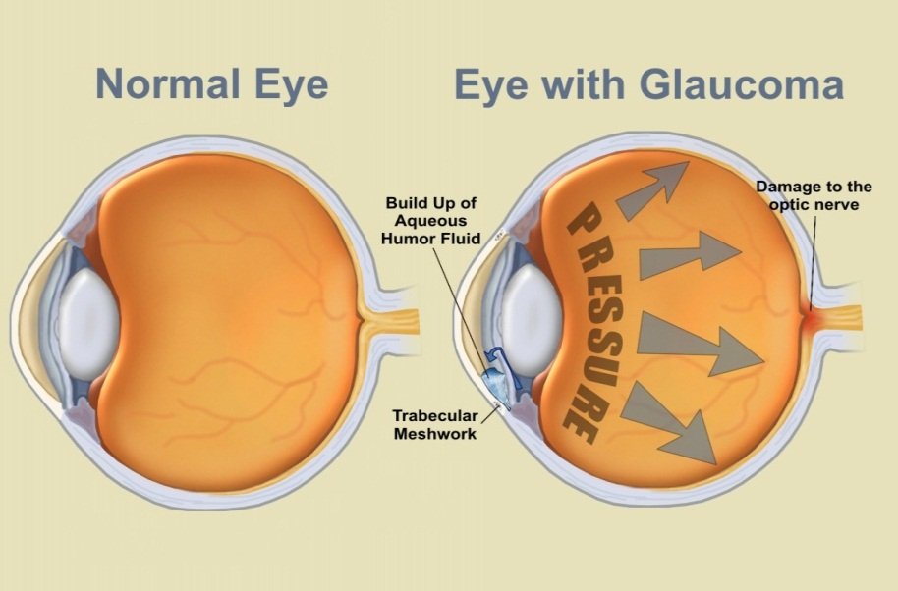
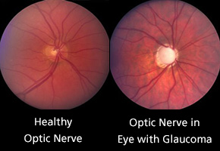
Risk factors for glaucoma
Age
Elevated Intraocular Pressures
Race
Gender
Family History of Glaucoma
Extreme refractive error
Diabetes
Cataracts
Previous eye injuries
Use of Corticosteroids

Slide 48
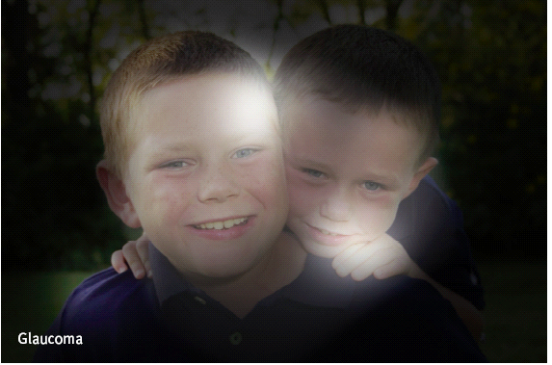
Glaucoma – functional implications
No functional implications in early stages
Silent disease
Difficulty adjusting to lighting changes (e.g. between indoors and outdoors)
Occasional blurred vision
Seeing a halo around lights (angle closure)
Increased sensitivity to glare and light
Difficulty identifying the edge of steps or road
Tripping over or bumping into objects

Slide 49
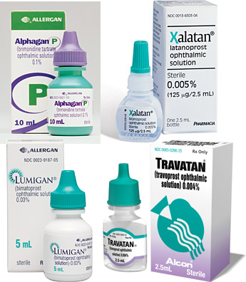
Treatment of glaucoma
Treatments are available but early detection is the key
Lost vision cannot be recovered. Treatment aims to prevent further vision loss
Treatment may involve medication (eye drops), laser and/or other surgery as well as regular monitoring
Early glaucoma is often asymptomatic. Regular eye tests are most important
Long term compliance a major concern, 1/3 or more of patients indicate poor adherence to drop therapy
  Asymptomatic
  Inability to instill drops

Slide 50
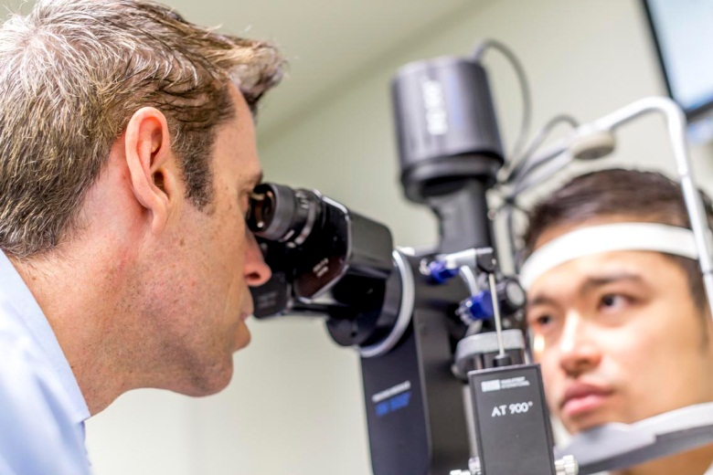
Prevention of glaucoma
Regular eye examinations to ensure early detection and treatment are the only way to control glaucoma and prevent vision loss
50% of people with glaucoma are unaware that they have it

Slide 51
Ready-made spectacles
Wearing ready-made spectacles can be:
Convenient
Accessible (“I lost my glasses”)
But there can be downsides:
Headaches, asthenopia (eye strain) can occur (they won’t damage your eyes)
Wearing them may delay people from getting a thorough eye exam

Slide 52
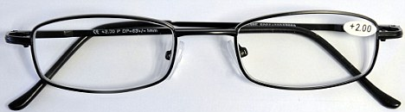
Ready-made spectacles
What you can do as a pharmacist:
Be prepared to discuss eye health with people purchasing ready-made spectacles, especially for the first time
Ask them:
  When was the last time the patient had a proper eye test?
  Do they have any symptoms, have they noticed any sudden changes in vision?
  Are they aware of their local eye care practitioners?
In some states, ready-made spectacles must be sold with a sticker reminding people of the importance of regular eye health check-ups

Slide 53
Am I dealing with an eye emergency?
Use these quick questions to guide you

Slide 54
Red flags:
Is this an eye problem with sudden onset symptoms?
Are the symptoms severe?
Has the patient lost vision in one/both eyes?
Is there injury or trauma to the eye?
Are the symptoms accompanied by other suspicious symptoms (e.g. slurred speech, severe headache or pain, loss of physical coordination, or mental confusion?)

Slide 55
How urgent is a referral?
The who: | Symptoms/signs
Emergency department today | Sudden Vision loss Sudden double vision Trauma Severe pain Foreign Body (Penetrating) Severe swelling
Optometrist or GP today | Unilateral red eye Blurred vision Foreign Body (superficial). Optometrists can remove foreign body from eye.
1-2 days to an optometrist | Mild blur or mild red eye Mild eye pain Floaters or flashing lights

Slide 56
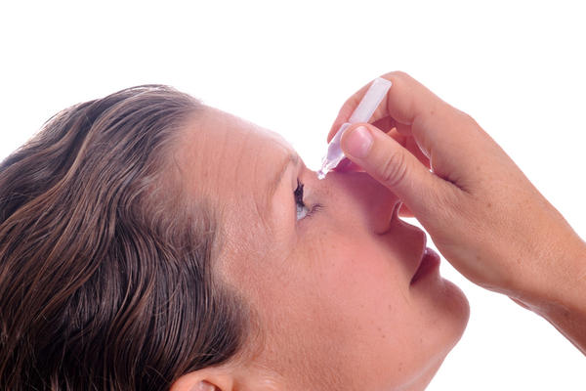
Emergency advice for chemical burns/splashes
Irrigate affected eye(s) with water for at least 15 minutes, then attend emergency department of hospital
Don’t apply drops, ointments, or other treatment
Patient to remove contact lenses where possible

Slide 57
Chloramphenicol: to OTC or not OTC?
Chloramphenicol: Schedule 3 treatment
Most common indications in eye problems: conjunctivitis and superficial infection with susceptible organisms
Importance of differential diagnosis - it’s not just a matter of failing “The Chlorsig Test”
Potential problems in making a diagnosis
  Are the symptoms really consistent with ‘just conjunctivitis’?
  Is the person a contact lens wearer?
  Will the organism be susceptible to this drug?
  How can I really see what is going on in the anterior eye?

Slide 58
Chloramphenicol: When a differential diagnosis matters
Primary care diagnosis | Confirmed ophthalmological diagnosis | Chloramphenicol Indicated by confirmed diagnosis? | Delay in referral | Preventable adverse outcome
‘Red eye’ | Acute anterior uveitis | N | 8 days | Severe permanent vision loss; pain
Conjunctivitis | Acute anterior uveitis | N | 7 days | Moderate permanent vision loss
Conjunctivitis | Bacterial keratitis | N | 2 days | Severe pain
‘Red eye’ - Conjunctivitis | Herpes zoster ophthalmicus (HZO) | N | 3 days | Mild permanent vision loss, severe pain, delay in antiviral treatment
Statham M, Sharma A and Pane A. Misdiagnosis of acute eye diseases by primary health care providers: incidence and implications, MJA 2008; 189(7) 402-4.

Slide 59
Thank you!
For further queries please contact:
Optometry Australia on (03) 9668 8500, email: national@optometry.org.au
Useful Links
Find an optometrist: www.optometry.org.au/find-an-optometrist/
Full list of medicines optometrists can prescribe www.optometryboard.gov.au/registration-standards/endorsement-for-scheduled-medicines/board-approved-scheduled-medicines-list-for-endorsed-optometrists.aspx
Patient education and eye-related stories: www.goodvisionforlife.com.au

