Slide 1
Falls prevention

Slide 2
As you get older, so do your eyes
This can affect your life in many ways

Slide 3
Visual changes due to age
Slower to adjust to altered light levels
More sensitive to glare
Blurred vision
Loss of contrast
Decrease in depth perception

Slide 4
Diabetes facts
Nearly 5% of Australians have diabetes
More than 70% of people with diabetes will develop diabetes related eye problems within 15 years of diagnosis

Slide 5
Vision is a risk factor for falls
A number of studies of the risk of falling have found a link with decreased vision

Slide 6
Different aspects of vision to consider
Visual acuity
Contrast sensitivity
Visual field ( your side vision)

Slide 7
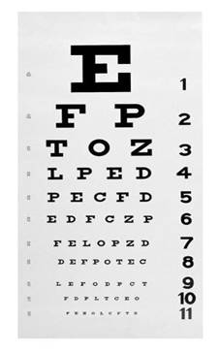
Different aspects of vision to consider
Visual acuity
  A measure of how clearly you can see
  Measured with a letter chart at a distance (usually 6m)

Slide 8
What causes a decrease in visual acuity?
Refractive errors
  Short-sightedness
  Long-sightedness
  Astigmatism
  Presbyopia
Eye disease

Slide 9
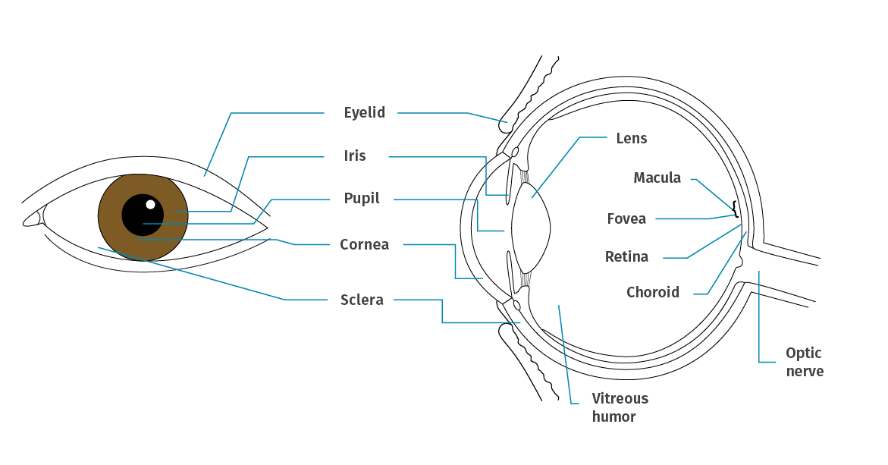
Diagram of an eye

Slide 10
Normal focus

Slide 11
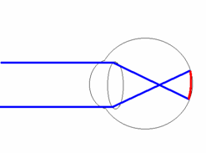
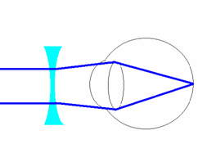
Short sightedness (myopia)
Distance vision is blurry – near vision usually okay
Short sighted focus
Short sighted correction

Slide 12
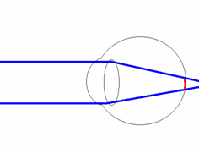
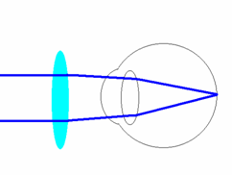
Long sightedness (myopia)
Difficulty seeing clearly and comfortably up close
Long sighted focus
Long sighted correction

Slide 13
Astigmatism
The eye is shaped more like an Aussie Rules football than a basketball
Focusing error that causes blur in one direction

Slide 14
Presbyopia
Begins from age 40+
Small print is clearer if held further away
The lens inside the eye is less flexible
Reading glasses restore close vision

Slide 15
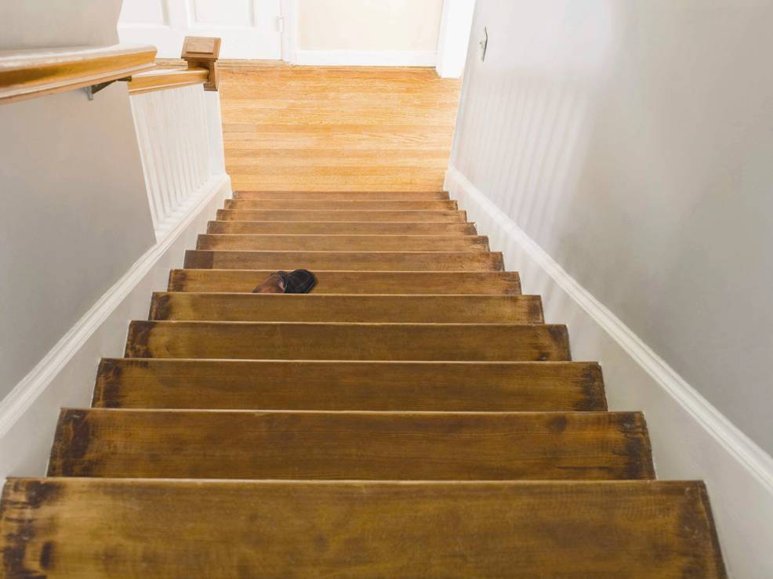
Different aspects of vision to consider
Contrast sensitivity
  How clearly can shades, patterns or edges be differentiated
  Steps
  Changing floor conditions
  Edges
  Affected by lighting

Slide 16
What causes a decrease in contrast sensitivity?
Age
Cataract
Macular degeneration
Diabetic retinopathy

Slide 17
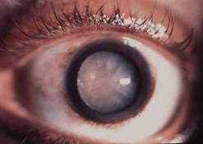
Cataract
Cloudiness in lens of eye
Blurred vision
Usually gradual loss of vision
Common after 60
May require surgery

Slide 18
Age-related macular degeneration
Deterioration of central retina
Affects close vision
Distorted vision, patches missing
Some treatment is available

Slide 19
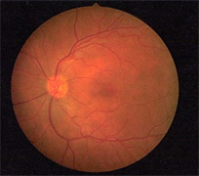
Normal retina
Retinal blood vessels
Optic nerve
Macula

Slide 20
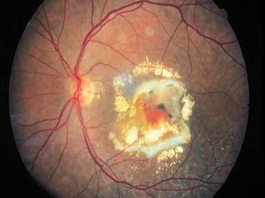
Age-related macular degeneration

Slide 21
Diabetic retinopathy
Changes to retinal blood vessels
More likely when
  Person has been diabetic for a long time
  Blood sugar is not controlled well
Some treatment available
Requires regular eye review

Slide 22
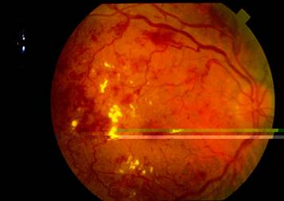
Diabetic retinopathy

Slide 23

Different aspects of vision to consider
Visual field
  How much side vision do you have?
  Mobility
    Steps
    Objects on floor
    Doorways

Slide 24
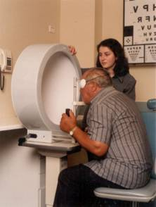
What causes a decrease in visual field?
Glaucoma
CVA (cerebral vascular accident) or stroke
Both age related conditions

Slide 25
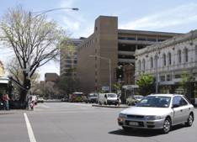
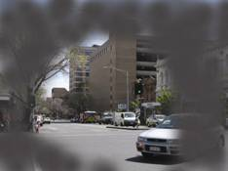
Glaucoma
Disease of optic nerve
Loss of peripheral (side) vision
Prevalence increases with age and family history
Treatment best in early stages

Slide 26
Regular eye exams are important
People who don’t have good vision are more likely to fall
No referral is required
Eye exams attract a Medicare rebate
Find your local optometrist at:
https://www.optometry.org.au/find-an-optometrist/

Slide 27
Optometrists
Provide a thorough vision and eye health exam
Detect and diagnose eye health problems
Prescribe and supply glasses and contact lenses when required
Diagnose and treat eye coordination and focusing problems

Slide 28
Download:
Guidelines for optometrists to help prevent falls in older patients (2020)

