Slide 1
Glaucoma

Slide 2
What is glaucoma?
Glaucoma is a degenerative disease of the optic nerve.
In its most severe form, glaucoma can result in tunnel vision or blindness

Slide 3
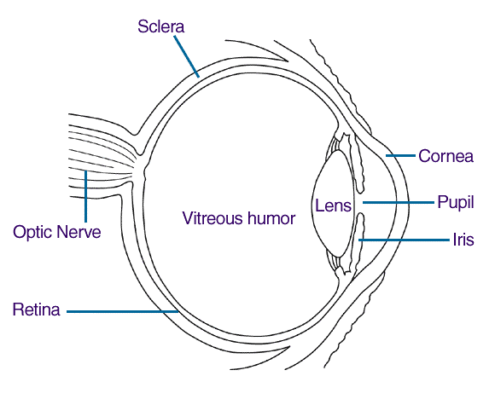
The optic nerve
The function of the optic nerve is to transmit information from the eye to the brain

Slide 4
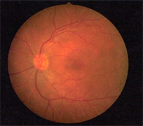
Normal retina
Veins
Optic nerve
Macula

Slide 5
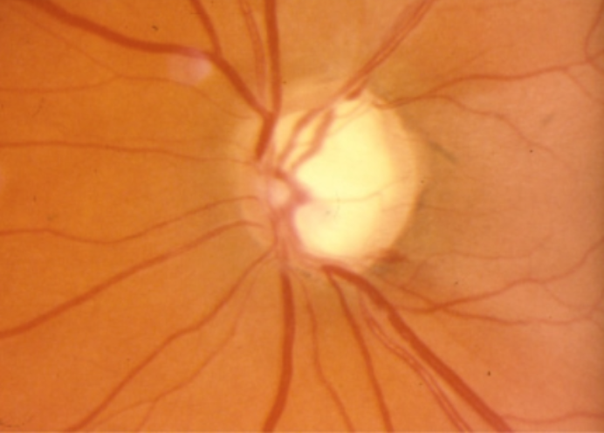
Damage to the optic nerve
Optic nerve

Slide 6
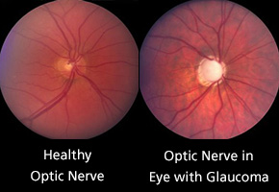
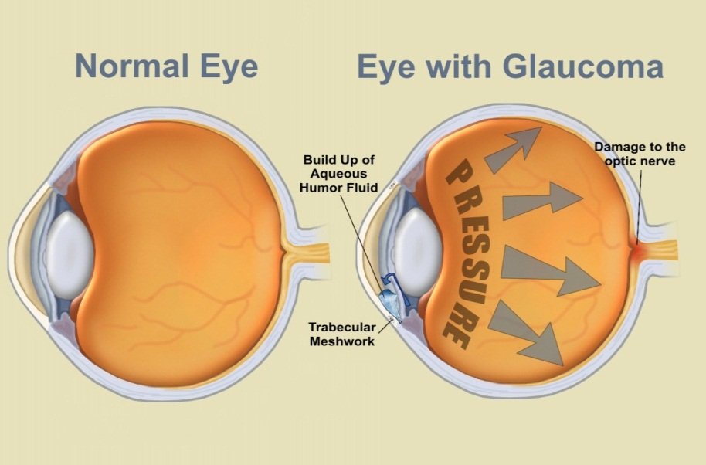
Side-by-side comparison

Slide 7
Detecting glaucoma
The pressure inside the eyeball may be higher than normal
Glaucoma is extremely difficult to detect yourself
Main risk factors:
Age: over 40
Family history: siblings, parents

Slide 8
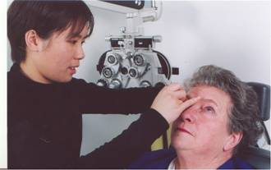
Tests for glaucoma
Tonometry
Measures the pressure inside the eyeball by:
Non-contact tonometry
e.g. a puff of air
Contact tonometry
usually involves the use of drops

Slide 9
Tests for glaucoma
Ophthalmoscopy
Use of a bright light to examine the retina
Appraisal of the optic nerve head
colour
shape
cup in centre

Slide 10
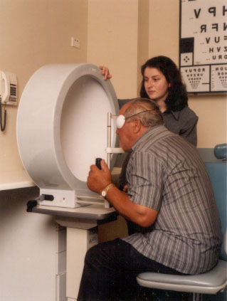
Tests for glaucoma
Visual field test
Usually a computerised test
Lights are shone in central and side vision
Patient presses a button each time these lights are seen

Slide 11
Tests for glaucoma
OCT (optical coherence tomography)
A computerised scan of your optic nerve and retina

Slide 12
Treatment for glaucoma
Medications
Surgery
Regular monitoring
Early detection and treatment is vital
Once vision is lost from glaucoma it can’t be restored
It is often hard for you to notice any changes in your own side vision until they are advanced

Slide 13
An eye exam every 2 years is recommended
Anyone over 40 AND anyone with a family history of glaucoma

Slide 14
Optometrists
Provide a comprehensive visual exam
Detect and diagnose eye health problems
Prescribe and supply glasses and contact lenses when required
Diagnose and treat eye coordination and focussing problems

Slide 15
To find an optometrist in your area:
www.optometry.org.au/find-an-optometrist/

Slide 16
Read more about glaucoma
http://www.goodvisionforlife.com.au/vision-problems/glaucoma/

