Slide 1
Inherited eye conditions

Slide 2
Some eye problems can run in the family
Refractive error
  Myopia
  Hyperopia
  Astigmatism
Strabismus
Retinitis pigmentosa
Colour vision defects
Glaucoma

Slide 3
Normal focus

Slide 4
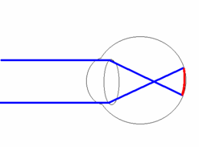
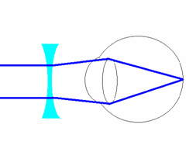
Short sightedness (myopia)
Distance vision is blurry – near vision usually okay
Short sighted focus
Short sighted correction

Slide 5
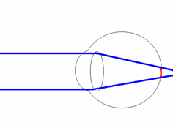
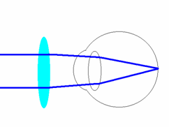
Long sightedness (hyperopia)
Difficulty seeing clearly and comfortably up close
Long sighted focus
Long sighted correction

Slide 6
Astigmatism
The eye is shaped more like an Aussie Rules football than a basketball
Focusing error that causes blur in one direction

Slide 7
Strabismus ‘ turned eye’
Eye/s turned in or out
Treatment options:
  Patching and glasses
  Surgery, if necessary

Slide 8
Retinitis pigmentosa
Inherited (usually), degenerative condition
Rare (1:4000)
Night blindness, reduced visual field
No treatment is yet available

Slide 9
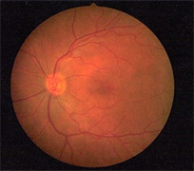
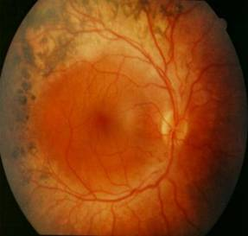
Retinitis pigmentosa
Normal retina
Retinitis pigmentosa

Slide 10
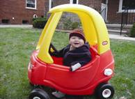
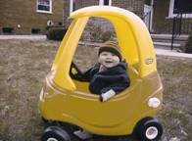
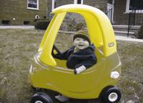
Colour vision defects
Most commonly red/green
8% of males , 0.5% of females
Affects colour discrimination, colour matching and career choices

Slide 11

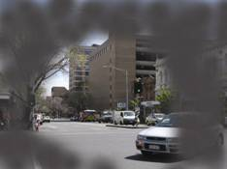
Glaucoma
Disease of optic nerve
Loss of peripheral (side) vision
Risk increases with age and family history
Treatment best in early stages

Slide 12

Early detection provides the best chance of effective treatment
If there is a visual problem in the family, have children tested carefully and regularly

Slide 13
Optometrists
Provide a comprehensive visual exam
Detect and diagnose eye health problems
Prescribe and supply glasses and contact lenses when required
Diagnose and treat eye coordination and focussing problems
Are university educated and undertake continuing professional education
No referral is required
Eye tests attract a Medicare rebate

Slide 14
To find an optometrist in your area:
www.optometry.org.au/find-an-optometrist/

