Slide 1
Optometry in Australia
Updated 11 January 2021

Slide 2
Optometrists regularly:
Diagnose and manage uncorrected refractive error with
prescription spectacle and contact lenses, low vision aids
Regularly diagnose and detect dry eye, eye lid disease, cataracts, macular degeneration, diabetic retinopathy and glaucoma
Foreign body removal
70% now therapeutic - treat common eye conditions with prescription eye drops

Slide 3
‘Eye problems are one of the most common health complaints with just over 10 million Australians reporting a long-term eye condition …’

Slide 4
The estimated total economic cost of vision loss within Australia is $16.6 billion or $28,905 per person aged over 40 years with vision loss.

Slide 5
21% of ‘blind’ people worldwide could be ‘cured’ with a pair of glasses

Slide 6
India and China account for approximately 50% of global vision impairment and blindness due to uncorrected refractive errors.
The estimated prevalence of uncorrected refractive error was 55 million and presbyopia was 177 million.

Slide 7
A recent study has estimated a global potential productivity loss of US$244 billion/year just from uncorrected short-sightedness (myopia)

Slide 8
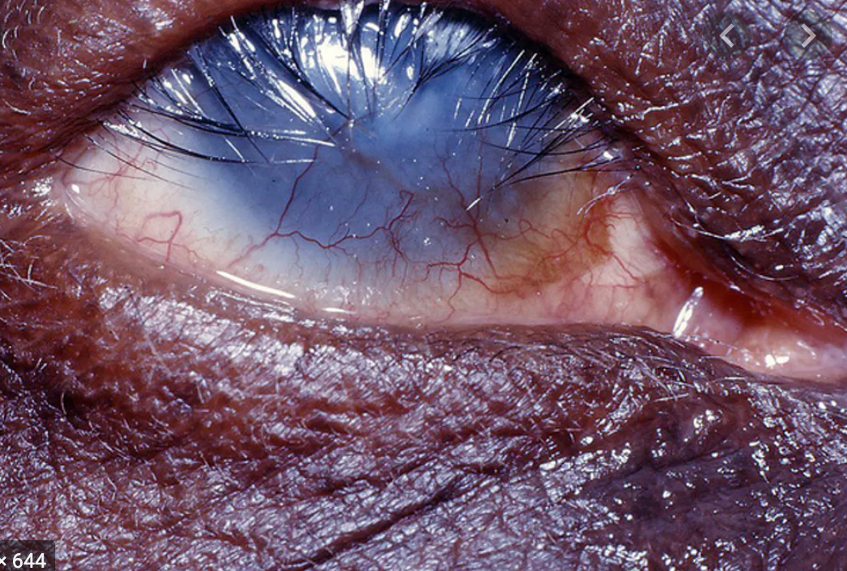
Trachoma & trichiasis
Australia is the only high-income country in the world that still has endemic trachoma and trichiasis.
This occurs almost exclusively in remote Aboriginal communities in the NT, South Australia and Western Australia.

Slide 9
Optometrist
An optometrist is a primary eye care provider
3.5 to 7 year University course (Undergraduate/Post Graduate)
Medicare provides a rebate on most optometry consultations
Patients do not need a referral to see an optometrist
Generally little or no waiting period for appointments
Optometrists will fast-track referrals to ophthalmologists (eye specialist) if necessary
To locate your nearest optometrist, please visit www.optometry.org.au

Slide 10
Eye health in Australia
As the population in Australia ages, the number of people who are blind or have vision loss is expected to be over 800,000 by 2020
90% of vision loss is preventable or treatable
Prevalence increases threefold with each decade over 40 years
80% of vision loss is caused by five conditions (listed alphabetically):
  Age-related Macular Degeneration (AMD)
  Diabetic retinopathy
  Cataract
  Glaucoma
  Under-corrected and uncorrected refractive error

Slide 11
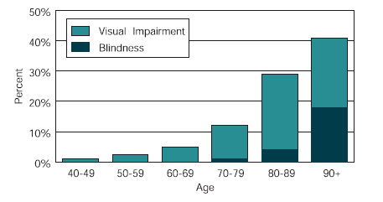
Vision loss in Australia
Center for Eye Research Australia, 2004, Investing in Sight – Strategic Interventions to Prevent Vision Loss in Australia.

Slide 12
Preventing vision loss
People with vision impairment are at a greater risk of suffering from secondary conditions:
falls
depression
early special accommodation
increased risk of hip fracture
increased early mortality
social isolation

Slide 13
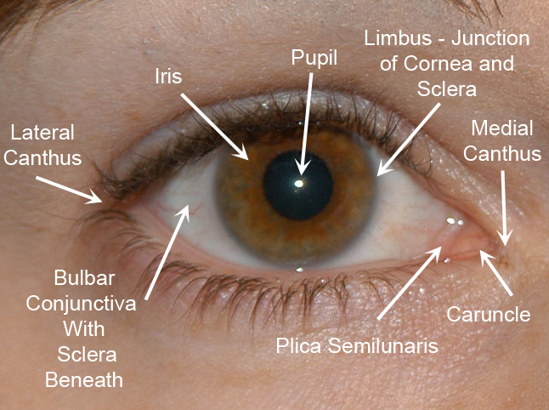
External anatomy of the eye

Slide 14
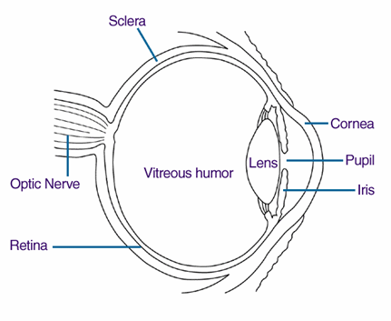
Internal anatomy of the eye

Slide 15
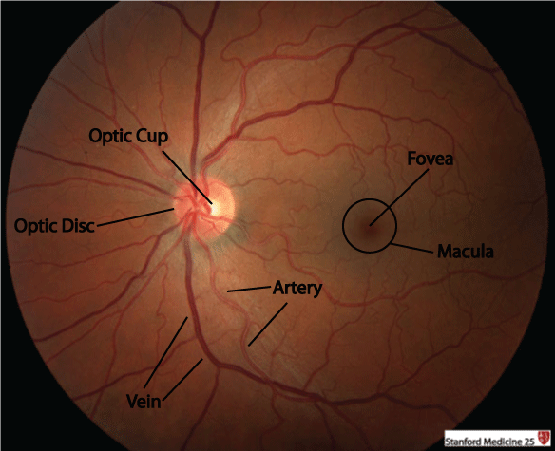

Anatomy of the retina

Slide 16
Normal focus

Slide 17
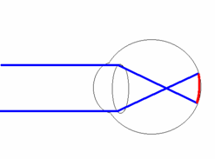
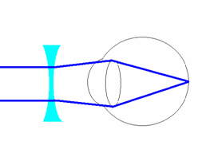
Short sightedness (myopia)
Distance vision is blurry – near vision usually okay
Short sighted focus
Short sighted correction

Slide 18
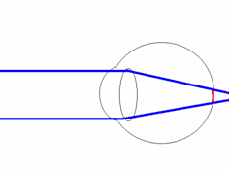
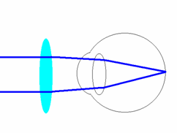
Long sightedness (hyperopia)
Difficulty seeing clearly and comfortably up close
Long sighted focus
Long sighted correction

Slide 19
Astigmatism
The eye is shaped more like an Aussie Rules football than a basketball
Focusing error that causes blur in one direction

Slide 20
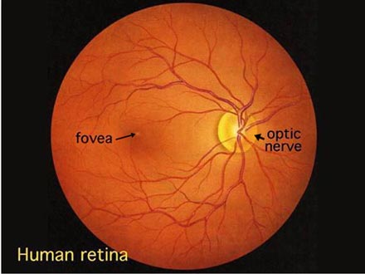
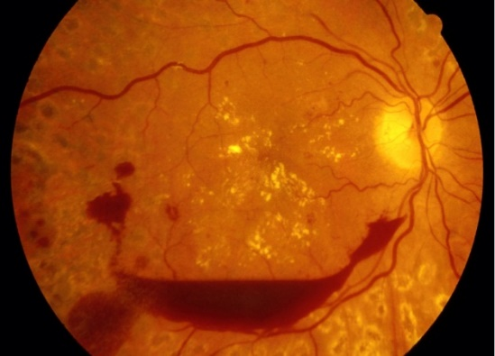
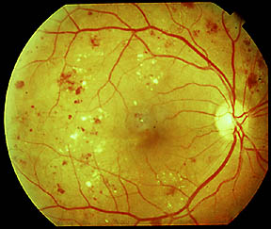
What is diabetic retinopathy?
This condition is a complication of diabetes
It affects the small blood vessels of the retina
Blood vessels begin to leak and bleed inside the eye
Healthy retina
Diabetic retinopathy

Slide 21
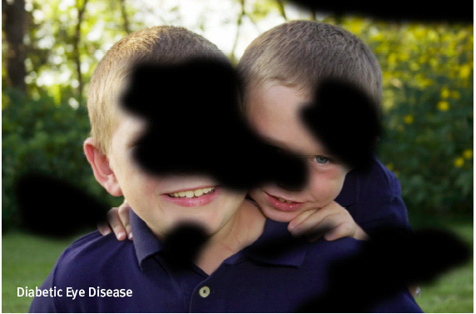
Diabetic retinopathy - functional implications
Difficulty with fine details (e.g. when reading or watching television)
Fluctuations in vision from hour to hour or day to day
Blurred, hazy or double vision
Difficulty seeing at night or in low light
Being particularly sensitive to glare and light
Having difficulty focusing

Slide 22
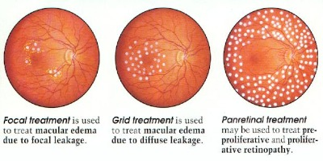
Treatment and prevention of diabetic retinopathy
Early detection and timely treatment is essential
98% of severe vision loss can be prevented with early detection and timely laser treatment
Reduction to the severity of eye disease can be achieved with optimal control of
  Blood Sugar Levels
  Blood Pressure
  Cholesterol Levels

Slide 23
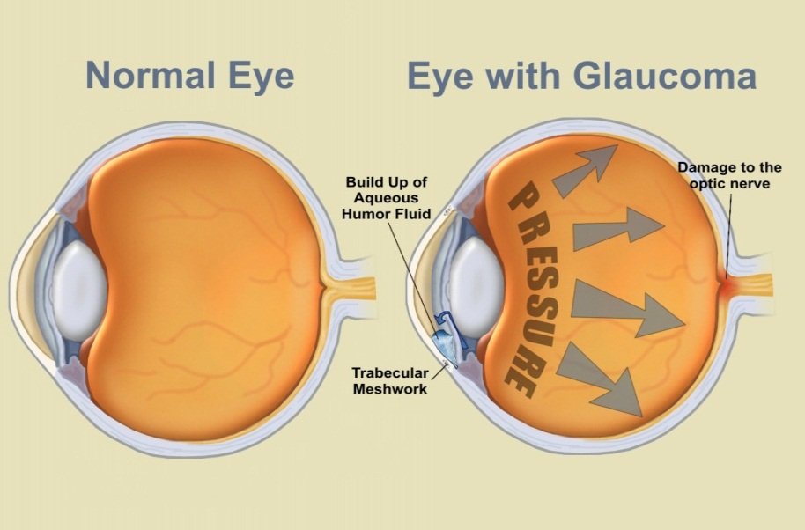
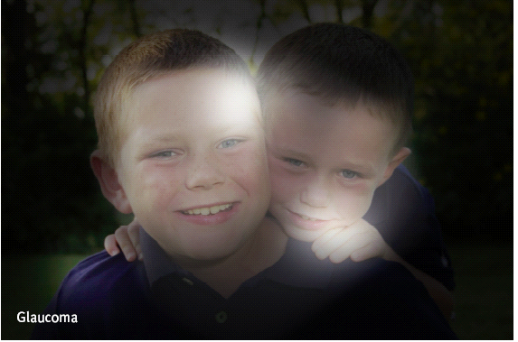
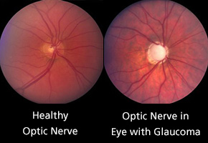
Glaucoma

Slide 24

What is age-related macular degeneration (AMD)?
Damage or breakdown of the macula that occurs with age

Slide 25
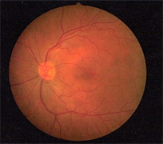
Normal retina
Veins
Optic nerve
Macula

Slide 26
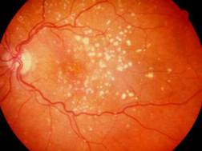
Types of AMD
Dry type
Better visual outcome
Small deposits called “Drusen” form around the macular area
No treatment, only regular review

Slide 27
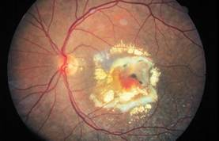
Types of AMD
Wet type
More serious
Fluid accumulates underneath retina, causing distortion
Requires immediate ophthalmological treatment

