Slide 1
UV and your vision

Slide 2
What is UV?
Ultra Violet radiation is a component of solar energy
Most solar UV radiation is absorbed by the ozone layer
More than 36,000 additional cases of eye problems will occur from ozone depletion

Slide 3
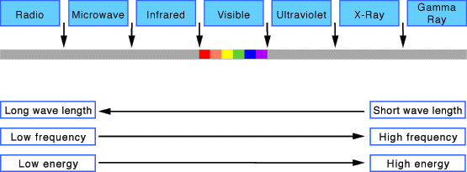
UV is a high-frequency light that is not visible

Slide 4
Eye damage thought to be caused by UV radiation
Cataracts
Pterygium
Cancer of skin around eye
Photokeratitis
Corneal degenerative changes
Age-related macular degeneration

Slide 5
Our eyes are more sensitive to UV harm than our skin

Slide 6
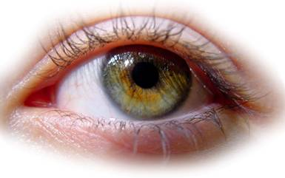
Diagram of the eye
Cornea
Pupil
Iris
Sclera
Conjunctiva
Lid margin

Slide 7
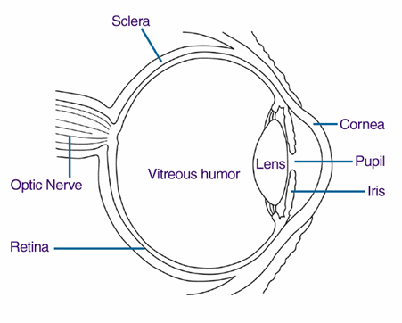
UV light can be absorbed by the cornea

Slide 8
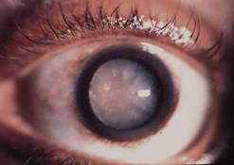
Cataract
Cloudiness in lens of eye
Usually gradual loss of vision
Common after 60
May require surgery

Slide 9
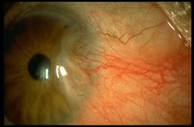
Pterygium
Like “skin” growing onto cornea
Bumpy surface gives irritation and redness
Can be surgically removed if close to centre of eye

Slide 10
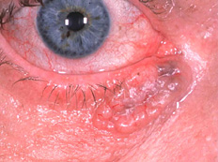
Eye lid lumps and bumps
Likelihood increases with age
Look for any change in size
Any new lesions should be checked ASAP

Slide 11
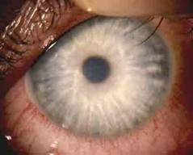
Photokeratitis
Occurs when exposed to large amount of UV (skiing, water sports)
Pain, watering, red eye
Easily prevented with eye protection

Slide 12
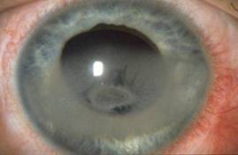
Corneal degenerations
Can be from build up of UV over the years
Cause pain, tearing, redness, light sensitivity
Difficult to treat

Slide 13
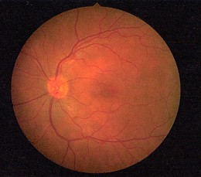
UV light can also be absorbed by the retina

Slide 14
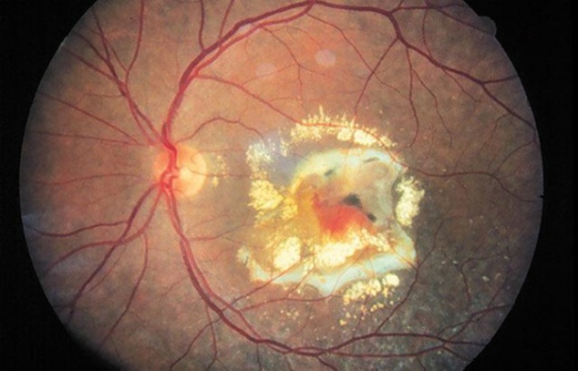
Age-related macular degeneration (AMD)
Deterioration of central retina
Affects close vision
Distorted vision, patches missing
Some treatment available

Slide 15
To protect your eyes from UV light
Wear sunglasses
Wear a broad brimmed hat
Eye damage from UV light exposure starts at childhood. Encourage children to wear hat/sunglasses.

Slide 16
Myths
Many people believe it is only the midday sun that poses the greatest UV threat but this is not the case. On some days, UV exposure to the eye before 10am and after 2pm may be higher due to the angle of the sun in relation to the eye.
Don’t be fooled by clouds, the fact you’re in shade or it’s winter time: a significant amount of damage to the eye can come from indirect light, from the side or reflected off surfaces e.g. sand, water, snow

Slide 17
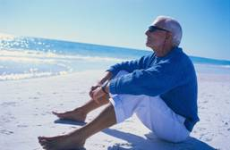
Sunglasses
Wrap around is good
Australian Standards
UV protection is unrelated to price
Choose a colour tint that is comfortable

Slide 18
Optometrists
Provide a comprehensive visual exam
Detect and diagnose eye health problems
Prescribe and supply glasses and contact lenses when required
Diagnose and treat eye coordination and focussing problems
Are university educated and undertake continuing professional education
No referral is required
Eye tests attract a Medicare rebate

Slide 19
To find an optometrist in your area:
www.optometry.org.au/find-an-optometrist/

Slide 20
Read more about sun safety and eyes
www.goodvisionforlife.com.au/better-vision/sun-safety-2/

